Slide 1

PROJECT
“OLIVA” WEB-SITE TESTING https://oliva.in.ua
GROUP 3
QA Engineer Maryana Matchyshyn
QA Engineer Liza Sheptytska
QA Engineer Dmytro Silayev
QA Engineer Volodymyr Andrukh
QA Engineer Anna Chulak
QA Engineer Olena Ivanovska

Slide 2
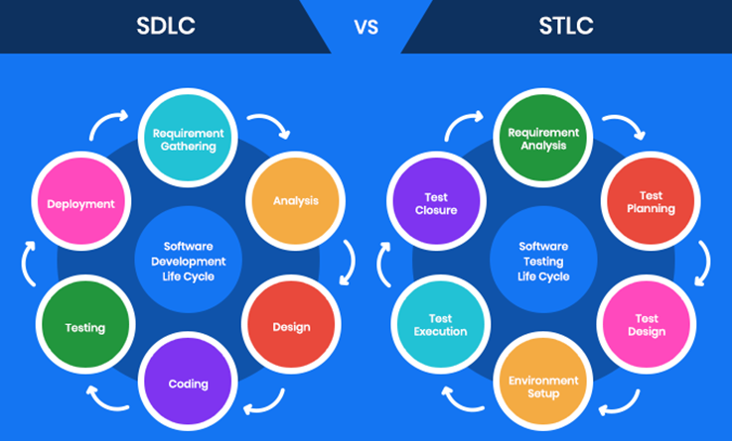
Project spoiler Software Testing Life Cycle

Slide 3
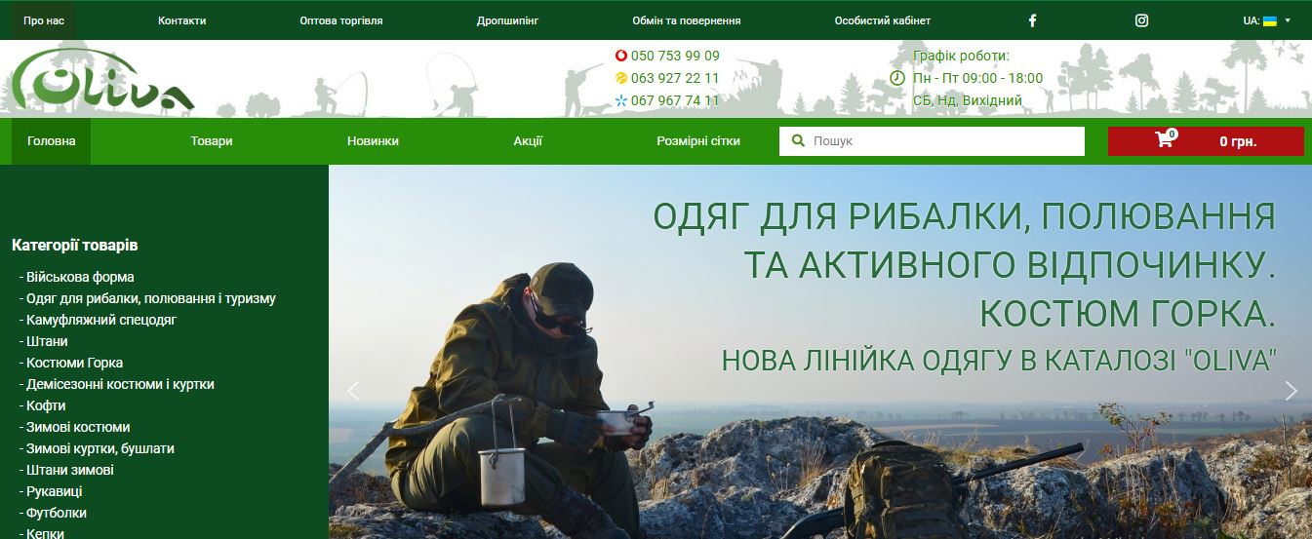
INSPECTION OBJECT https://oliva.in.ua

Slide 4
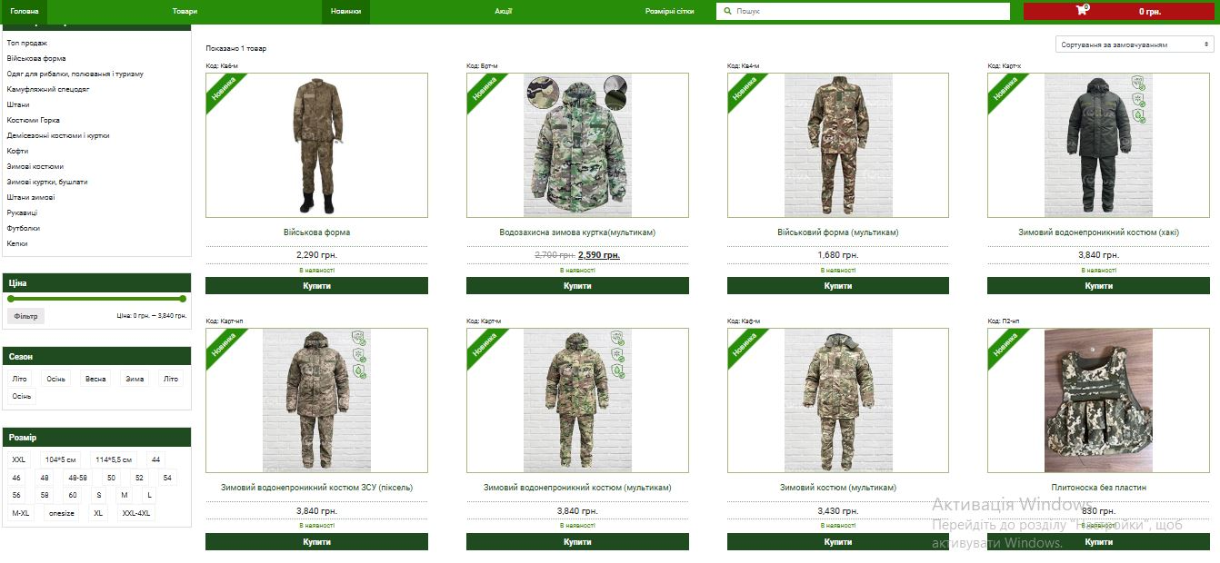
OLIVA is an online store of suits for hunting, fishing, active recreation and military clothing

Slide 5


THIS IS THE BEGINNING
OF OUR ANALYSIS
We defined:
What are the business goals
What are the user roles
What is the design structure
AND
Developed all the necessary documentation

Slide 6
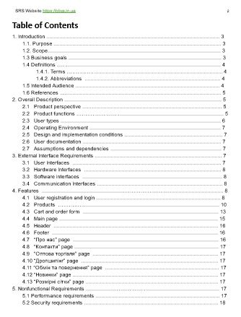
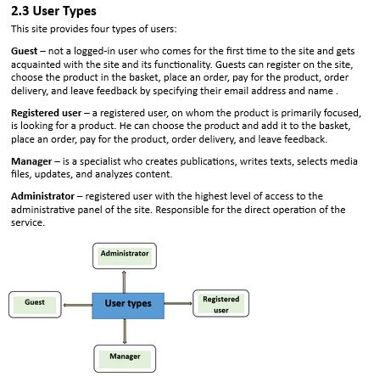
Business goals
Increase the number of customers in the company's physical warehouse office market;
Increase the number of customers in the company's online shopping store; B2С;
Increase the number of business customers. B2B - Business to business;
Placement of the information about all products, as well as promotional products, novelties and seasonal products. Рroduction of unique clothes according to the needs and sizes of customers;
Сonstant offer of updating clothes for hunting, fishing and tourism on the market of Ukraine;
Organization of product delivery to the client and placement of information related to the return of products;
Communication with the company sales department through social networks. Placement of all links to the company's social networks, phone numbers and contacts and the physical address of the company's warehouse office;
Provide customers with a convenient platform to search and purchase.

Slide 7
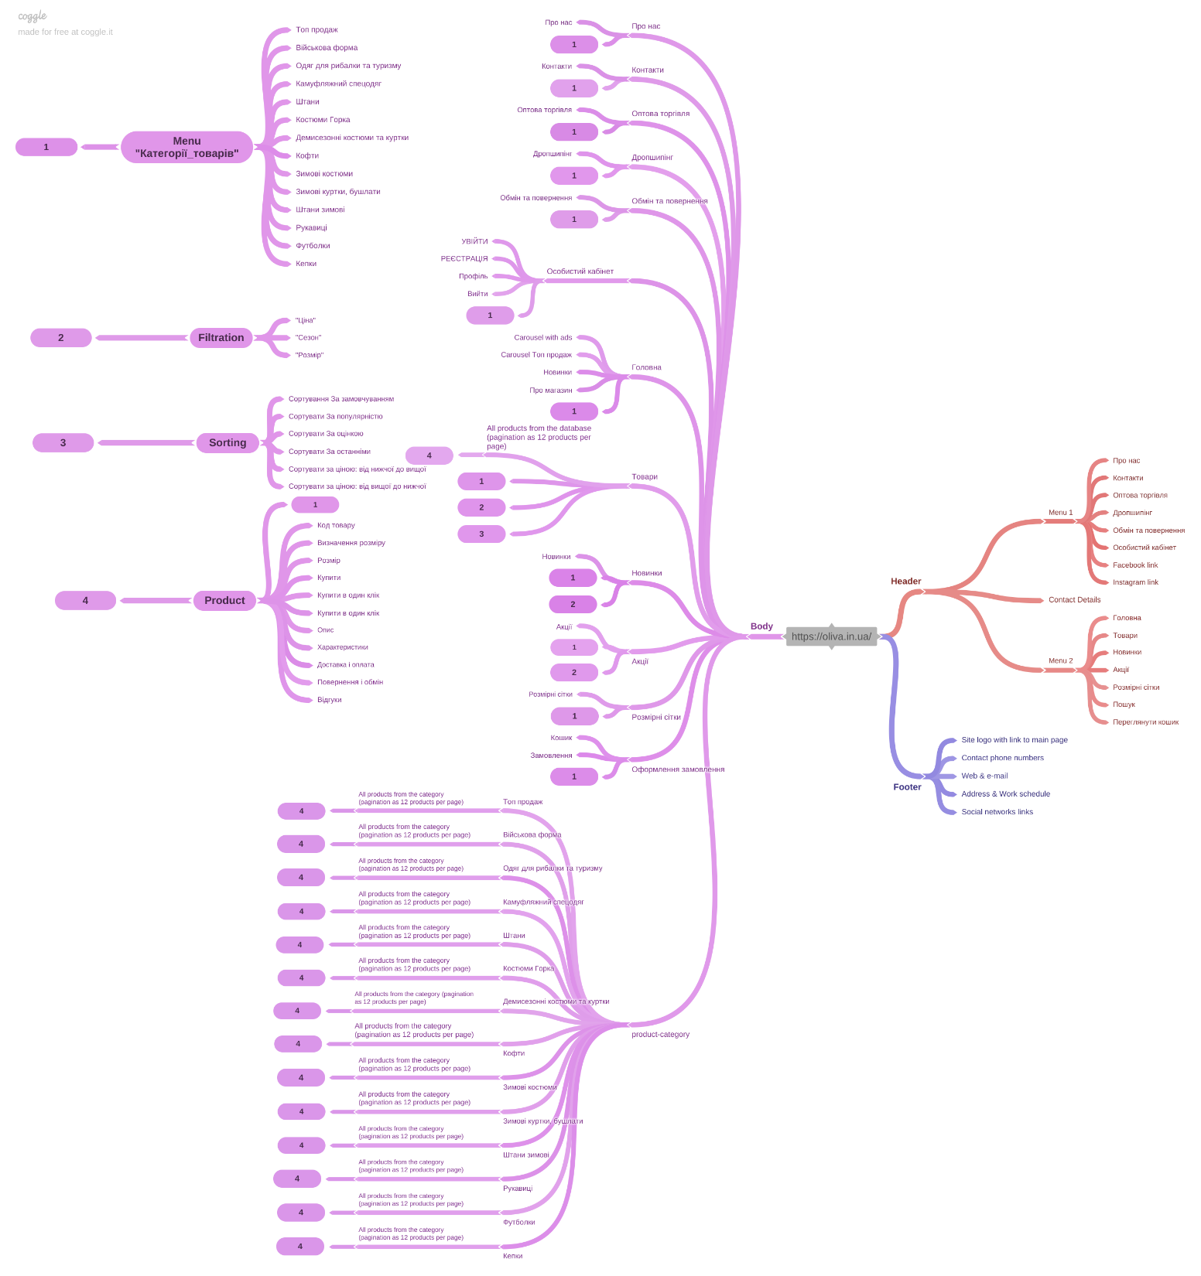
https://oliva.in.ua
Structure MindMap

Slide 8
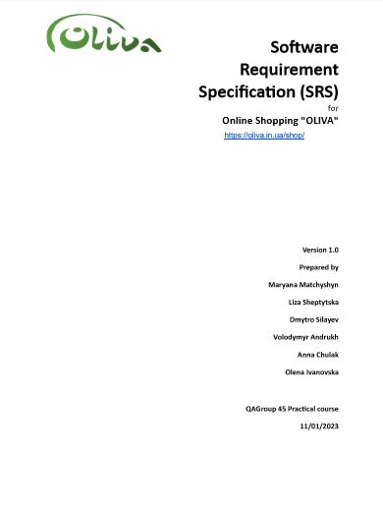
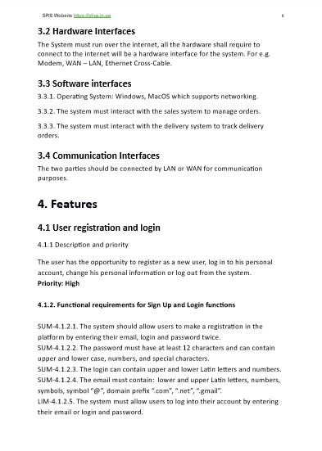

Slide 9
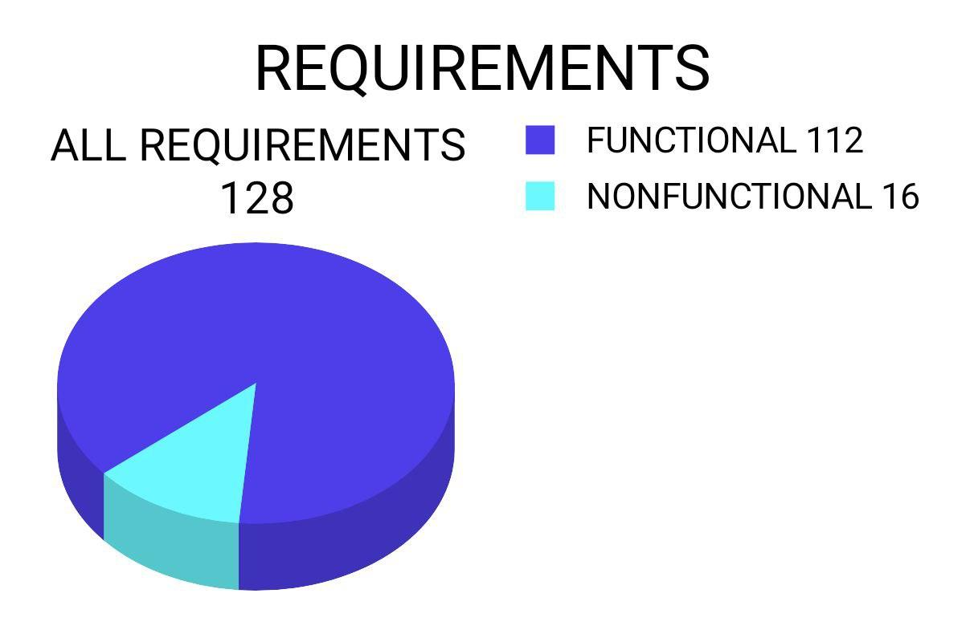

Slide 10
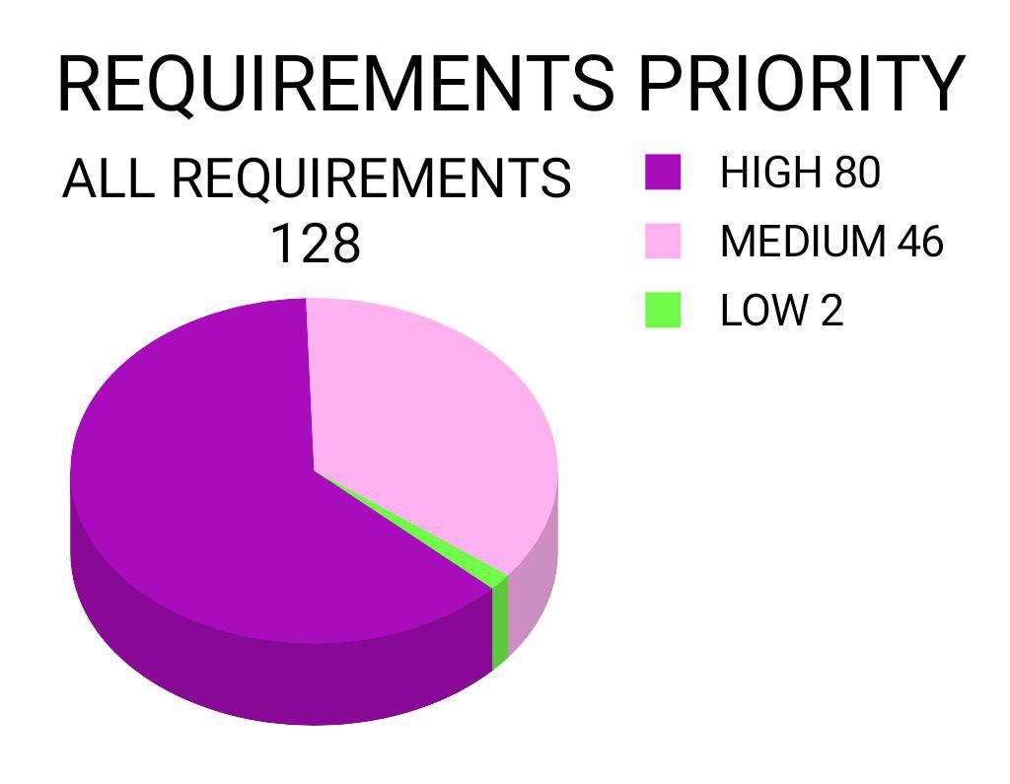

Slide 11
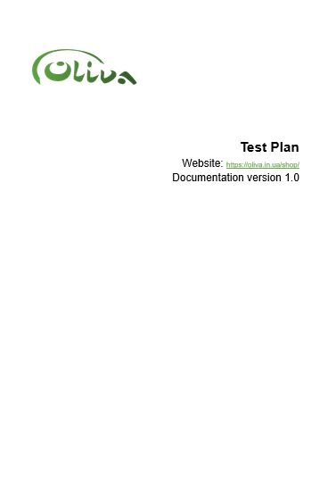
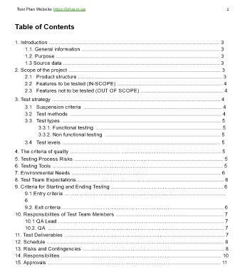
TEST PLAN
Features to be tested (IN-SCOPE)
Personal cabinet: Sign Up and Log In, User profile, Log Out
Products: Search Form, Menu “Product’s categories”, Filter “Price”, Filter “Season”, Filter “Size”, Sorting By default, By popularity, By rate, By last added, By price: from the highest to the lowest, By price: from the lowest to the highest; Adding goods to the cart. Feedback form.
Ordering: As not registered User, As Logged In User, By “Купити в один клік» button
Main page “Головна”
Header
Footer
Pages ‘Про нас’, ‘Контакти’, ‘Оптова торгівля’, ‘Обмін та повернення’, ‘Новинки’, ‘Акції’, ‘Розмірні сітки’.
Features not to be tested (OUT OF SCOPE)
External payment systems
Dropshipping feature (temporary not available)
Localisation testing

Slide 12
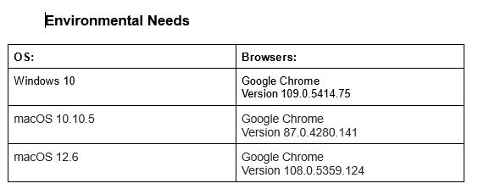




Slide 13
TEST TYPES
Functional testing
Manual testing
Automation testing
Non functional testing
GUI Testing
UX Testing
API Testing
Load Testing
Security Testing

Slide 14

Entry criteria
All the necessary documentation, design, and requirements
information should be available that will allow testers to operate
the system and judge the correct behavior
All the standard software tools including the testing tools must
have been successfully installed and functioning properly
Proper test data is available
QA resources have completely understood the requirements
QA resources have sound knowledge of functionality
Reviewed сhecklists, test cases and RTM
Exit criteria
All defined test cases & check-lists are passed and marked “Pass” status
A certain level of requirements coverage has been achieved
No high priority or severe bugs are left outstanding
All high-risk areas have been fully tested, with only minor residual risks left outstanding
The schedule has been achieved

Slide 15
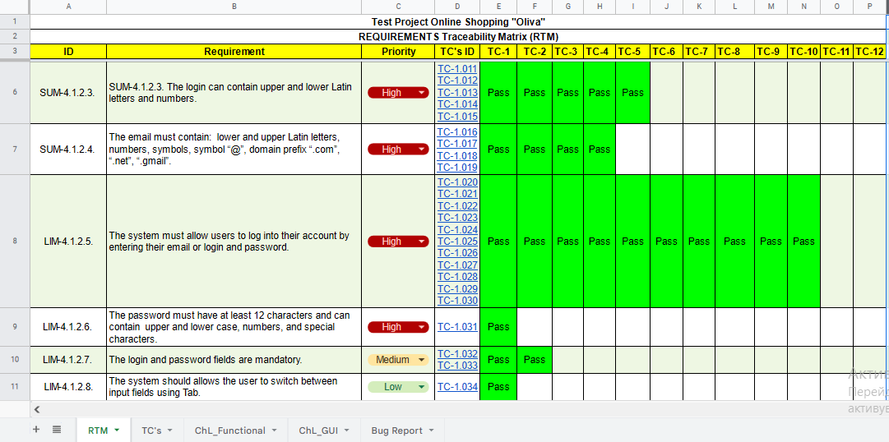
REQUIREMENTS (EXAMPLE OF DOCUMENTATION SECTION)

Slide 16
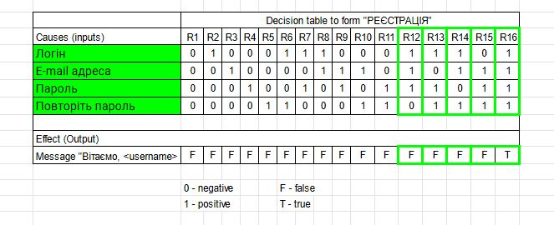
DECISION TABLE TO FORM"РЕЄСТРАЦІЯ"

Slide 17
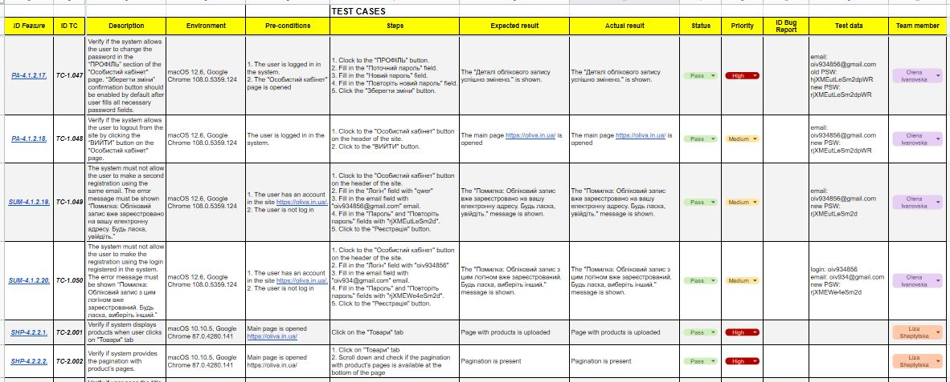
TEST CASES
(EXAMPLE OF DOCUMENTATION SECTION)

Slide 18
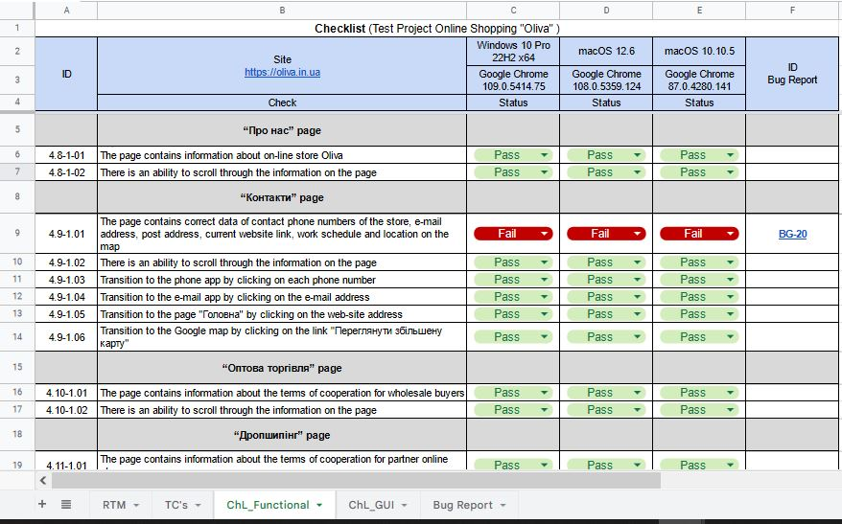
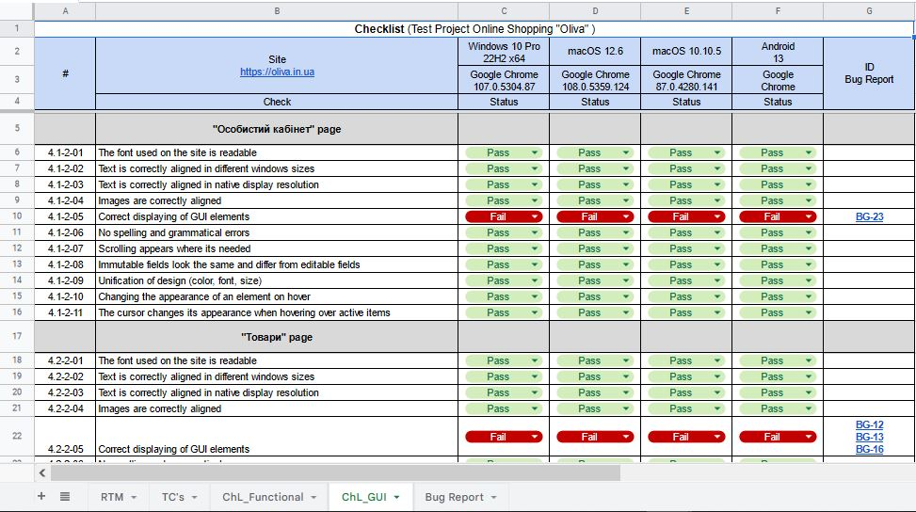
CHECKLIST_Functional / GUI

Slide 19
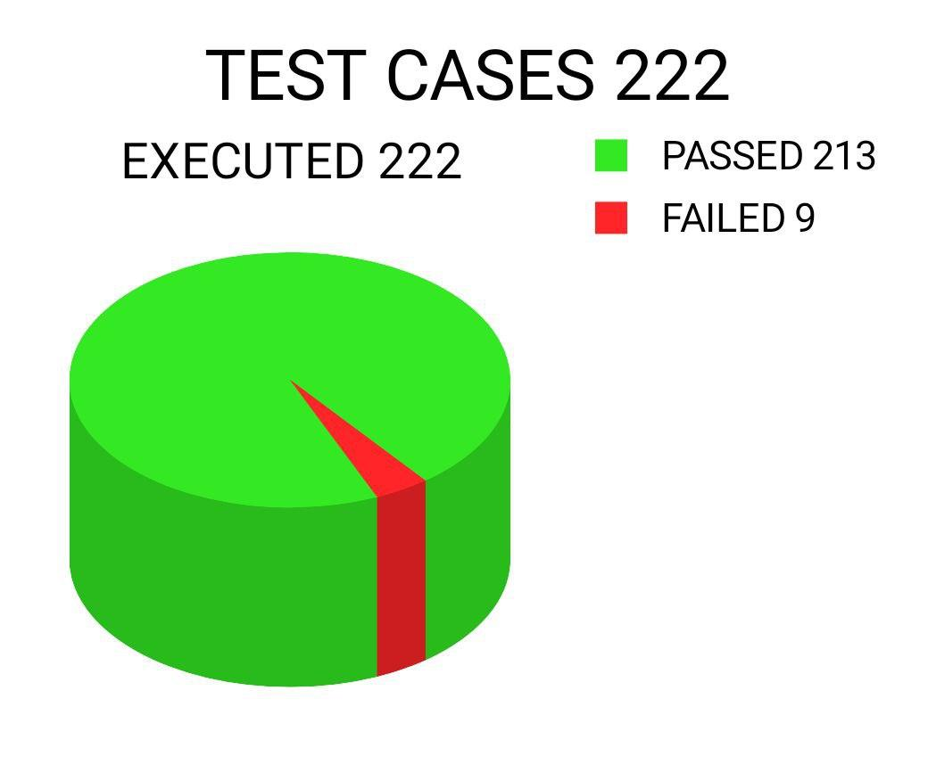
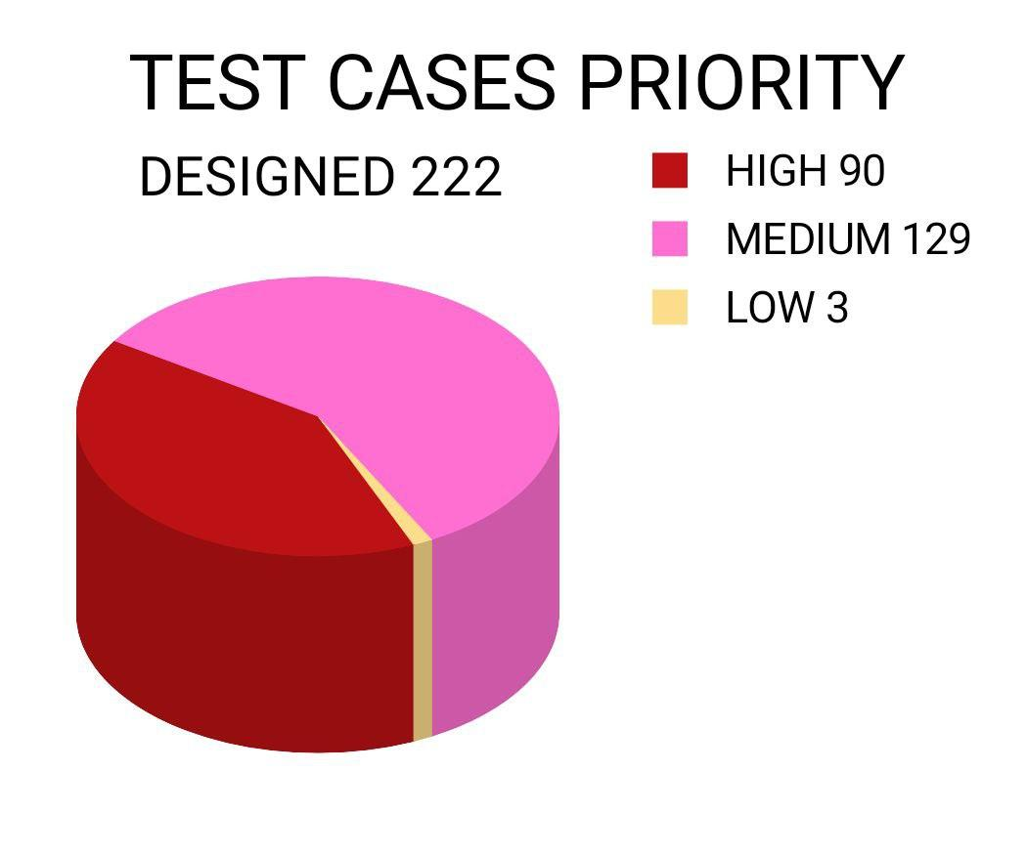
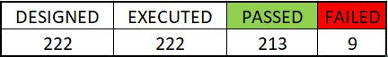
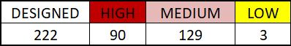
Based on the collected requirements 222 cases
were designed 100% of test cases were executed

Slide 20
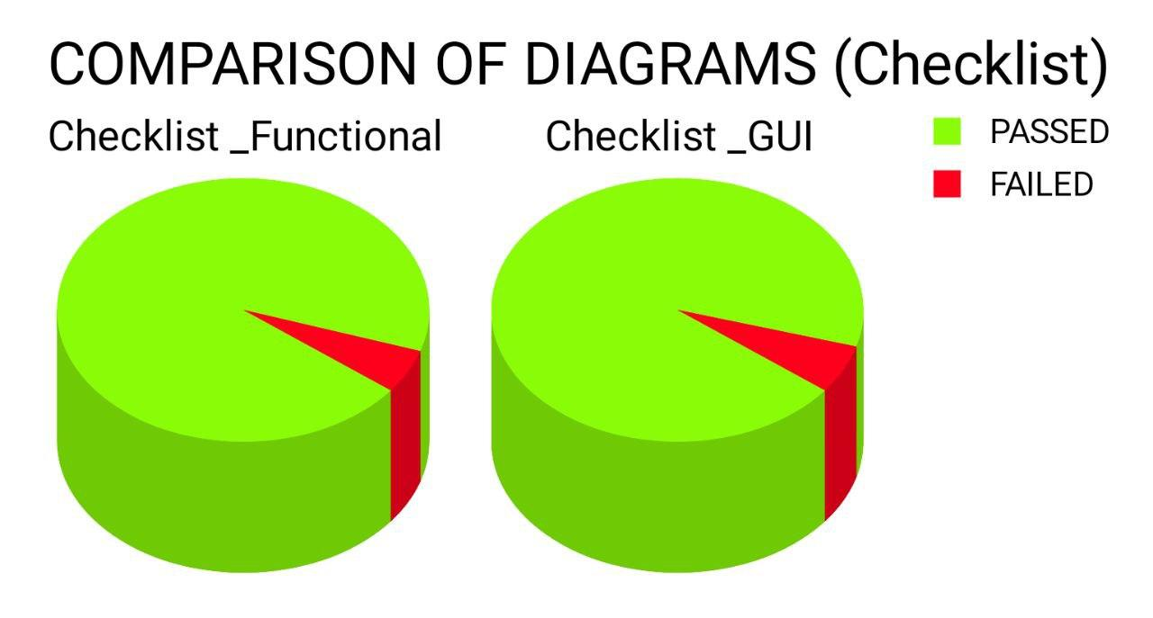
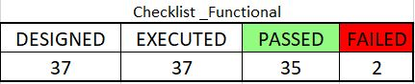
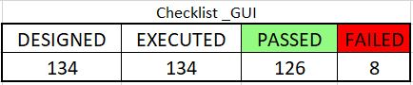
CHECKLIST_Functional / GUI

Slide 21
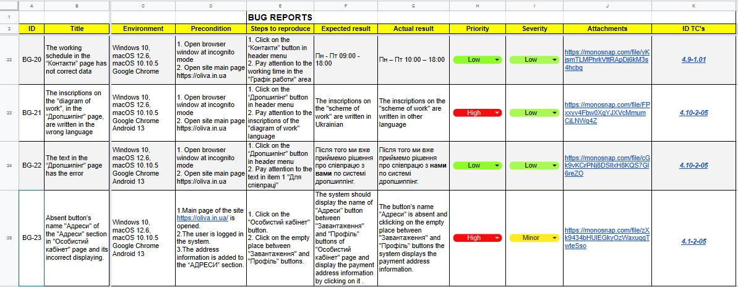
BUG REPORT
(EXAMPLE OF DOCUMENTATION SECTION)

Slide 22
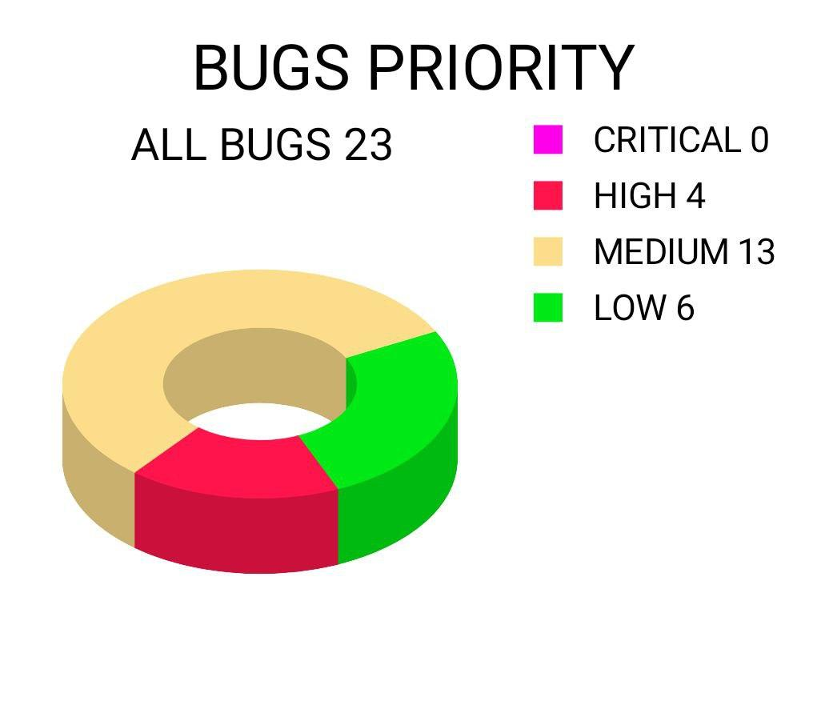
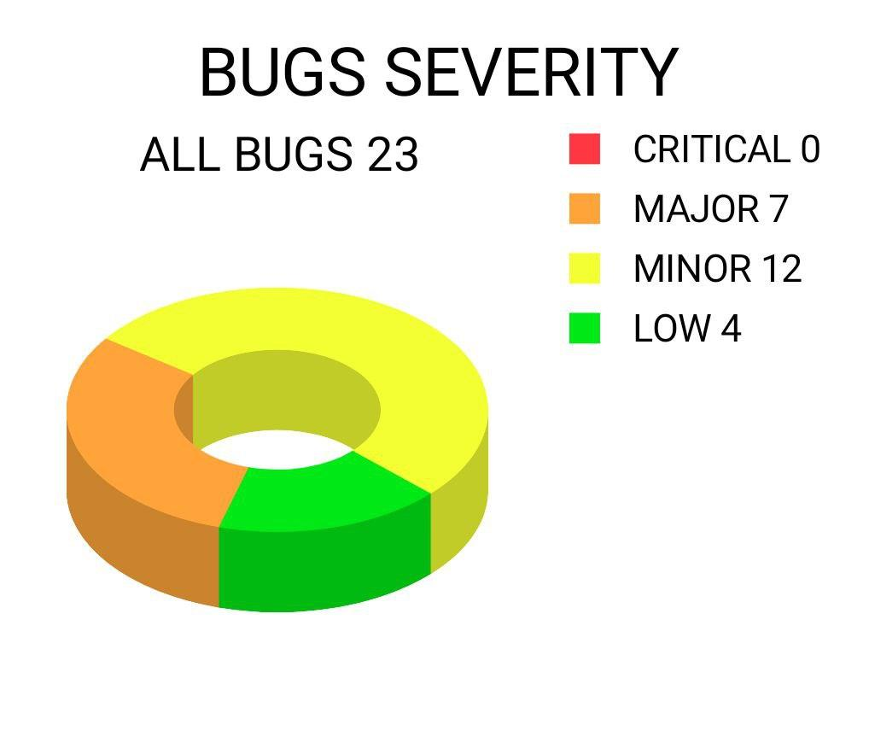

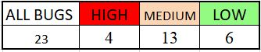
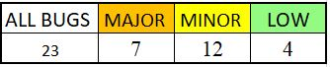

Slide 23


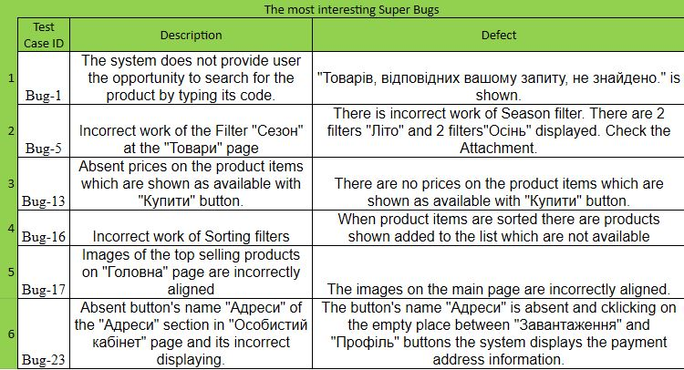

The most interesting Bugs

Slide 24
Demonstration
Bugs

Slide 25
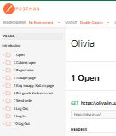
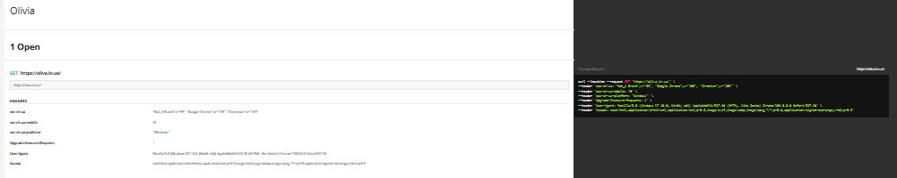

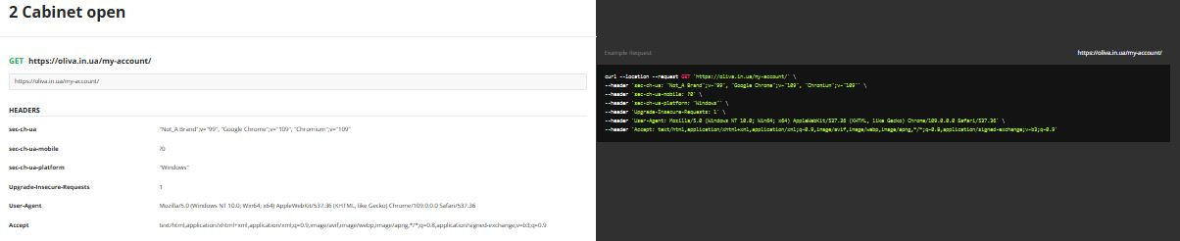
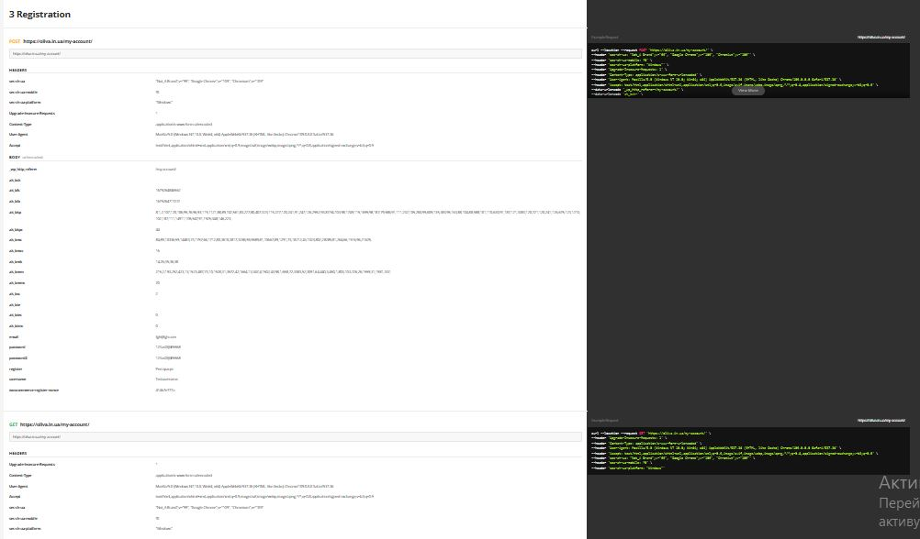
OLIVA_IN_UA Collection with GET and POST requests
API TEST

Slide 26
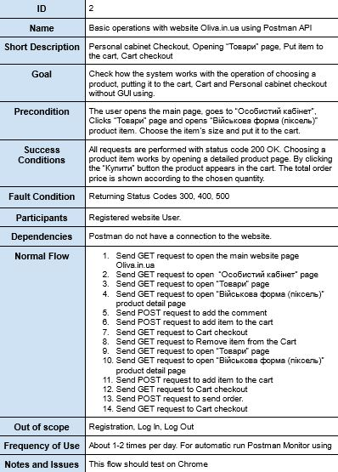
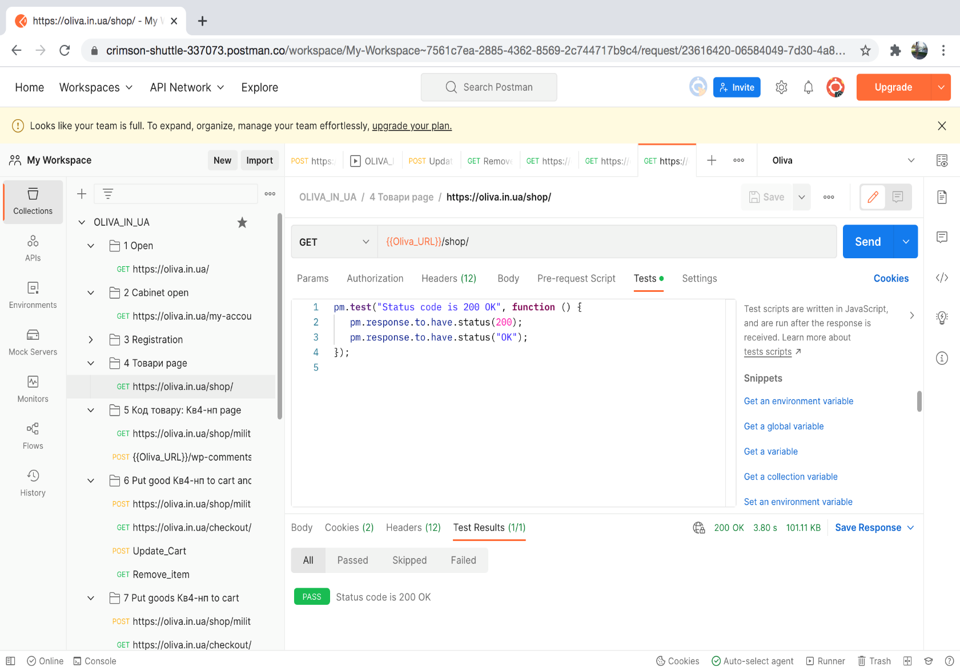
API TEST

Slide 27
Demonstration Execution
of the Postman API TEST collection

Slide 28
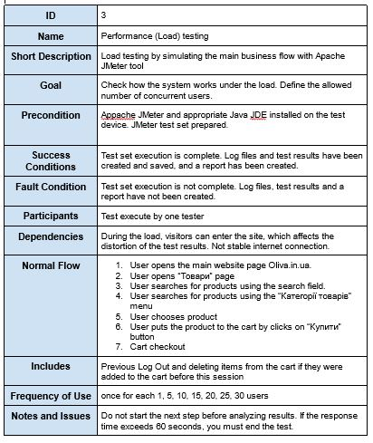
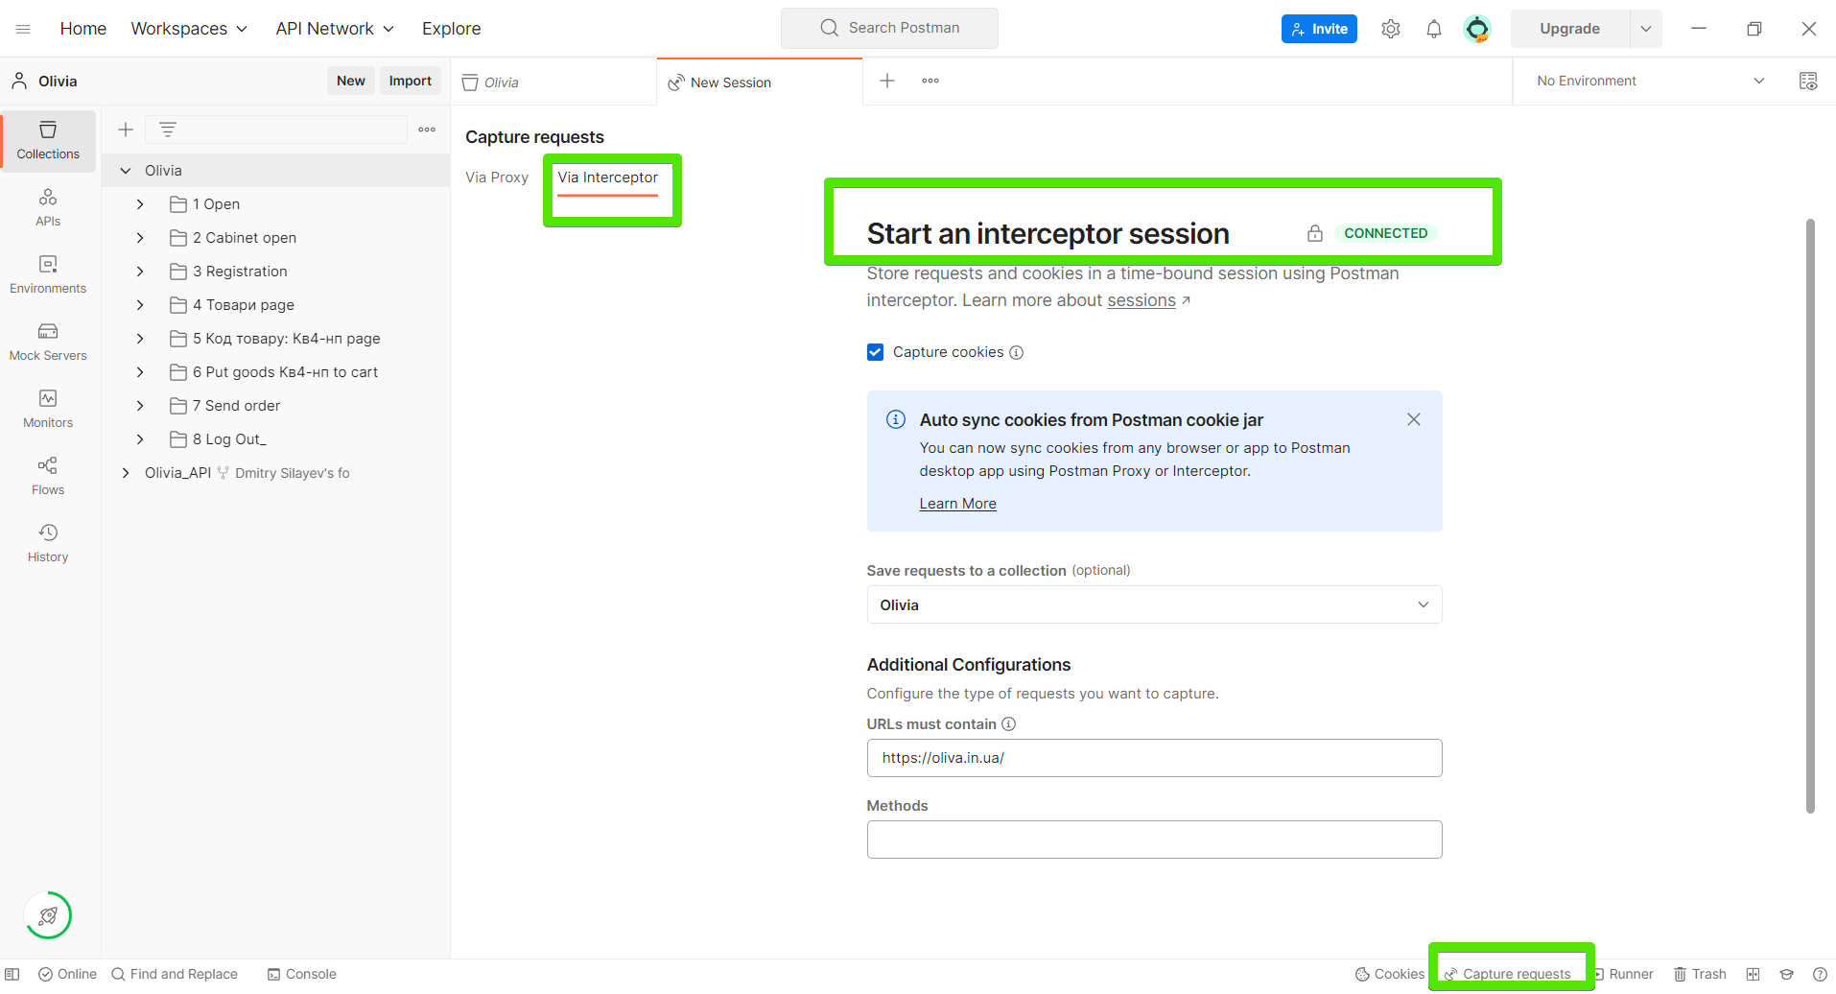
Use Case Performance testing
PERFORMANCE TESTING
1. Postman Interceptor

Slide 29
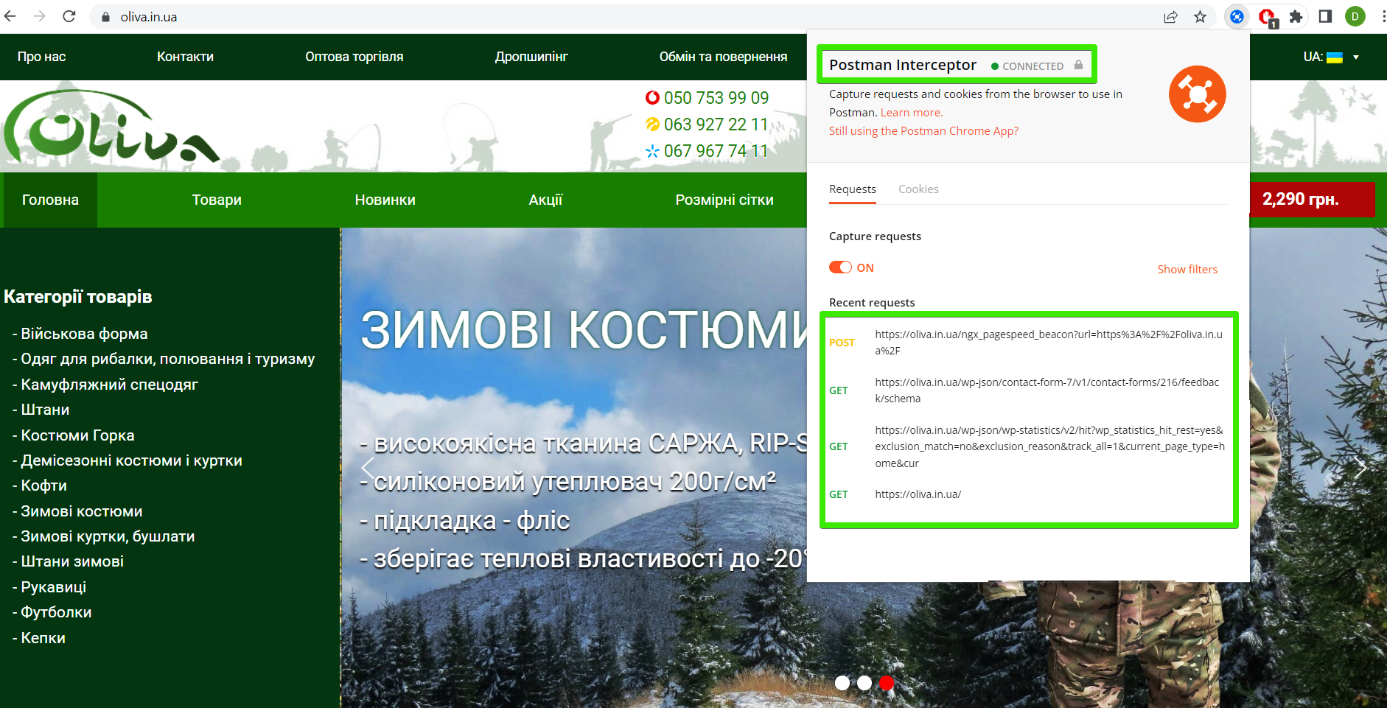
PERFORMANCE - 2. Postman interceptor Google extension

Slide 30
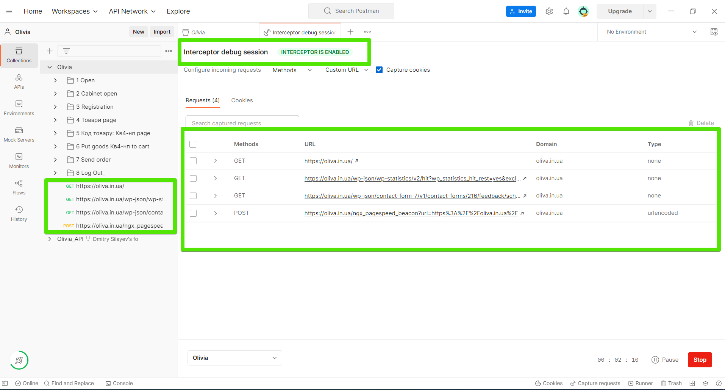
PERFORMANCE – 3. Interceptor debug session

Slide 31
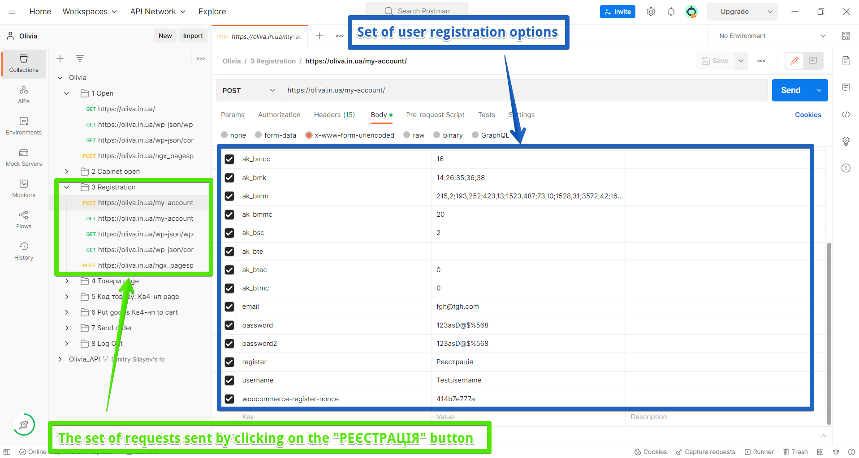
PERFORMANCE – 6. Requests set User registration options set

Slide 32

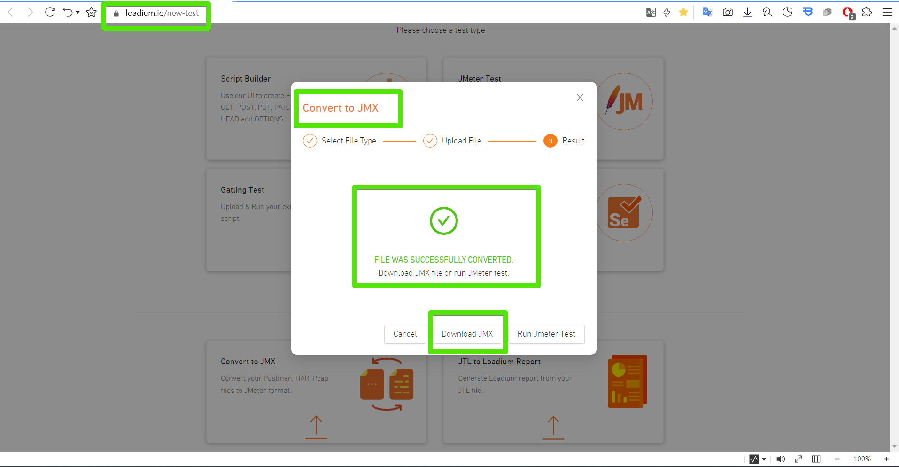
PERFORMANCE
4. Loadium Convertor

Slide 33

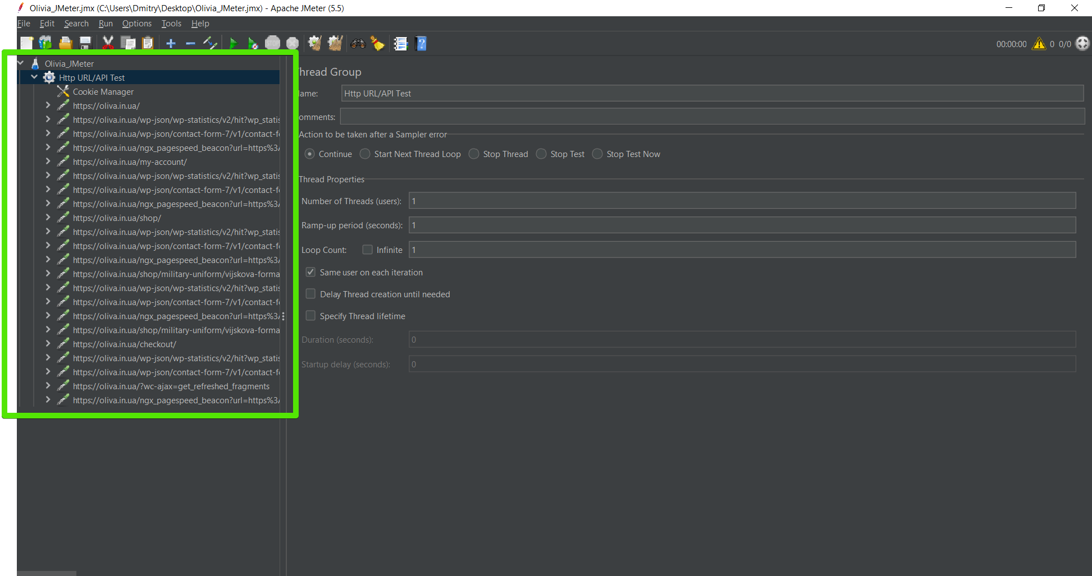
PERFORMANCE - 5. Apache JMeter

Slide 34
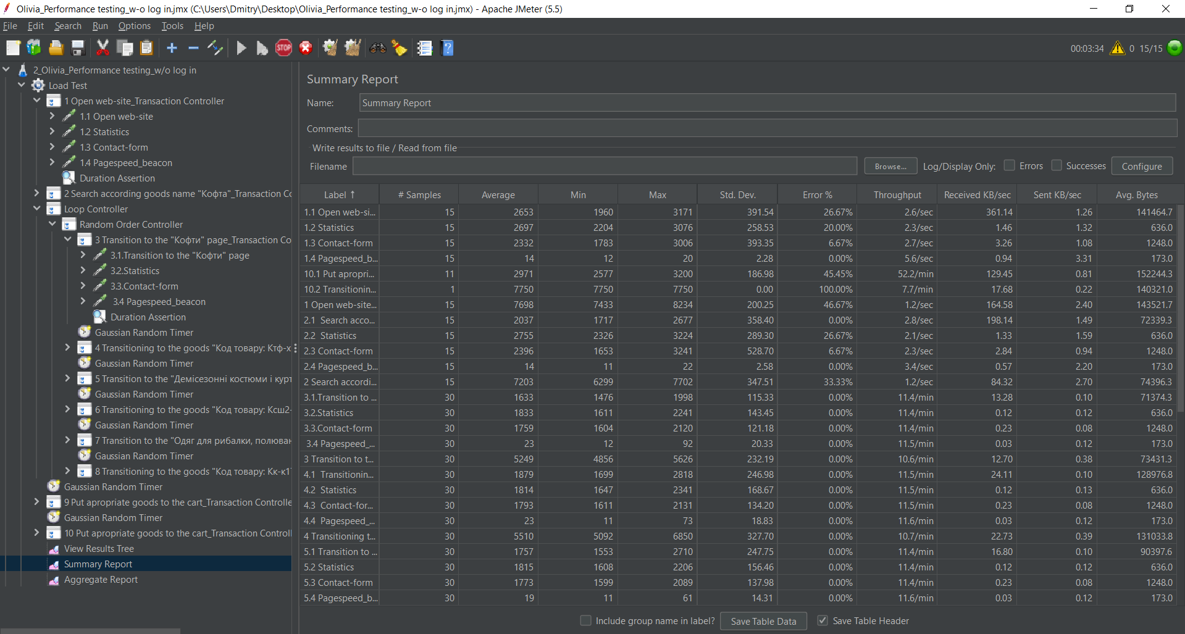
PERFORMANCE

Slide 35
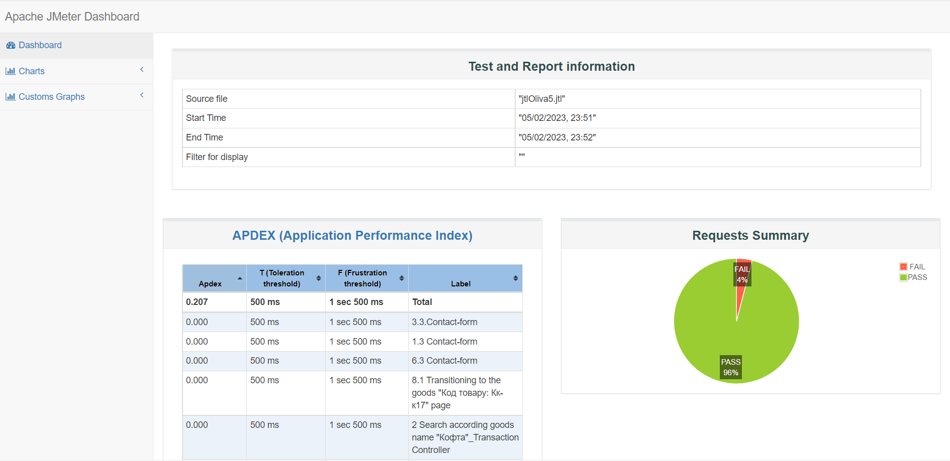
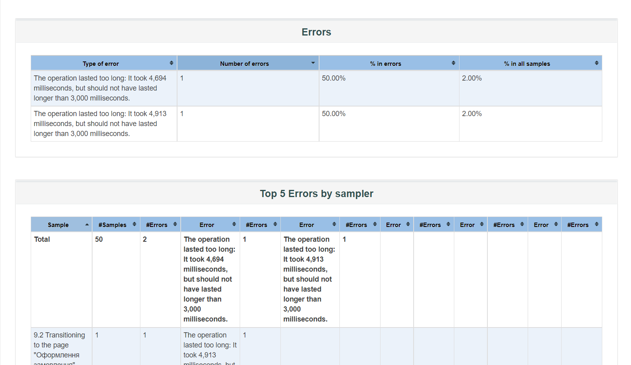
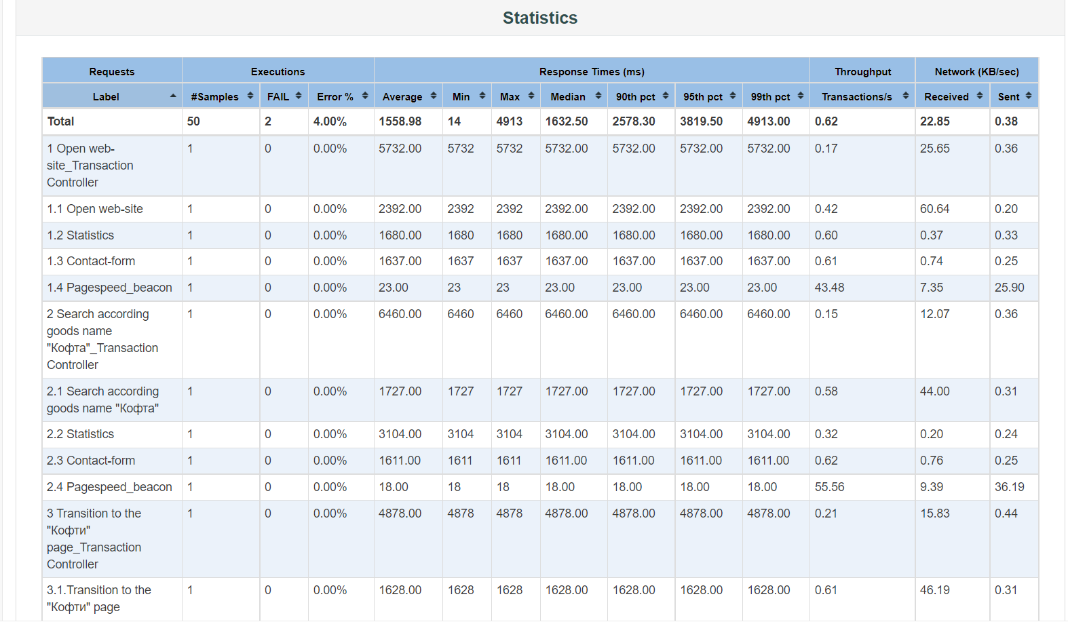
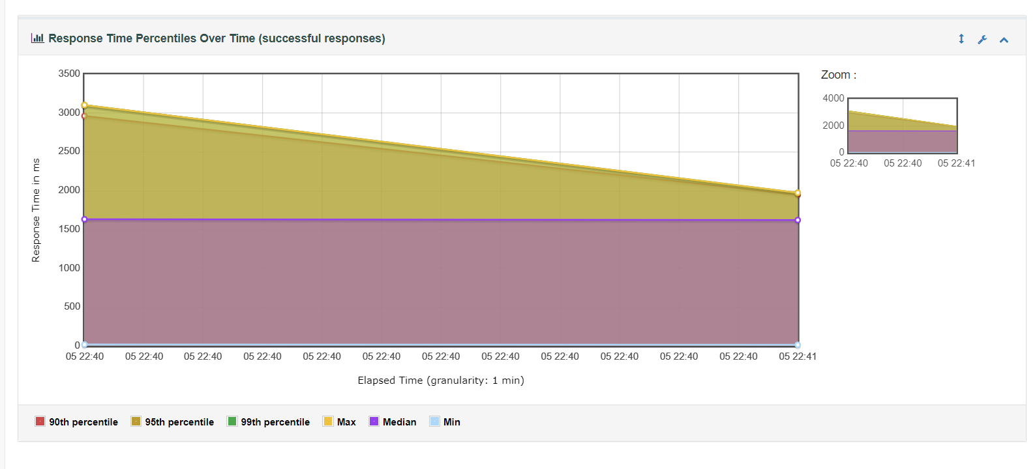
PERFORMANCE

Slide 36
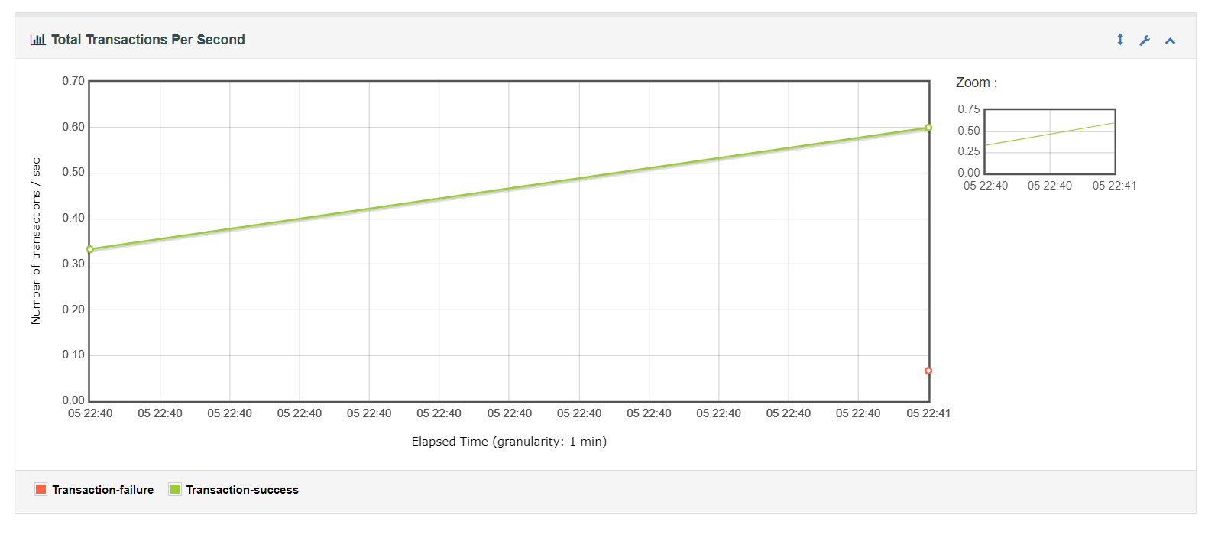




PERFORMANCE

Slide 37



PERFORMANCE

Slide 38


Security test ZAP Scanning Report

Slide 39



EXAMPLE
Security test ZAP Scanning Report

Slide 40


Security test H-X Technologies Scanning Report

Slide 41



EXAMPLE
Security test H-X Technologies Scanning Report

Slide 42


Slide 43




AUTOMATION TESTING
Use Case
SELENIUM IDE

Slide 44
Demonstration Selenium IDE Automation Testing

Slide 45


SUMMARY OF ACTIVITIES
!!! WOW :))))
This is a wonderful result
Estimated total time 378 hours

Slide 46


Slide 47


Slide 48



Slide 50

Test deliverables
Mind Map
Software Requirements Specification
Test plan
Requirements Traceability matrix
Test cases
Check-lists
Bug reports
Use-cases
API testing collection documentation
Performance Testing Report
Security Testing Report
Test summary report

Slide 51

Recommended Improvements As a result of testing, we recommend the following
Recommended Improvements As a result of testing, we recommend the following
- Fix bugs according bug-reports
- Improve site security according security report
- Improve Performance to decrease response time
- Improve sorting function to exclude not available goods
- we understand that the russian language is necessary for SEO promotion of the site in the eastern part of Ukraine. We recommend removing the flag and replacing the word "русский" with RU.

Slide 52

For the presentation, we choose green summer color because we wanted to share positive emotions

Slide 53


Our charts & graphics are like cakes and donuts, so everyone who will hire us, will feel how sweet cooperation with us

